Slide 1
Nutrition Analysis using Image Classification
By Rampalli Vivek
PavanTeja Varre
Anushka Pradeep
Srinija Ketavarapu
Nishachandran

Slide 2
Introduction
Basic Elements
Working of the Application
Basic Construction idea

Slide 3
Objectives of Research

Slide 4
Data Modelling
CNN-Training of data
Prediction of data
GUI creation using Tk

Slide 5
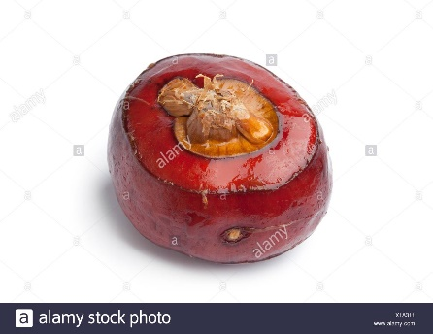
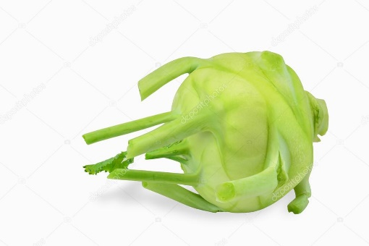
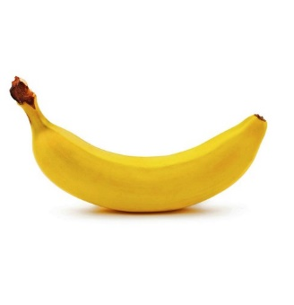
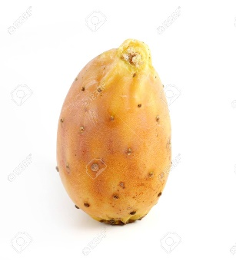
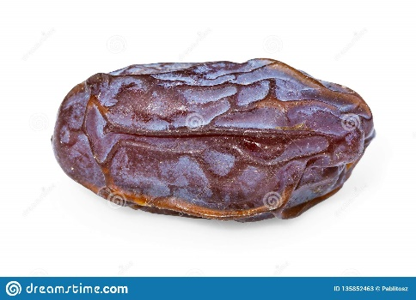
WORKING
Chestnut
Kohlrabi
Banana
Cactus Fruit
Dates

Slide 6
Conclusion

Slide 7
THANK YOU

